Slide 1

AGRI AI(SMART FARMING ASSISTANT) (FLUTTER PROGRAMMING)
Rameshwar Patil(G-01)
Vinay Kulkarni(G-07)
Aarti Suryawanshi(G-08)
Chandrashekhar Kate(G-10)
Guide: Prof.Ritu Dhudmal
DEPT. OF Computer Science & Engineering
PCET’s Pimpri Chinchwad University
Established under Govt. of Maharashtra Act No. V of 2023
Gut No. 44, 46, 48, 49 and 50, Sate, Maval (PMRDA) Dist. Pune-412106 Maharashtra, India

Slide 2
Outline
Details | No. of slides
Outline | 01
Introduction | 02
Problem Statement | 03
Objectives | 04
Scope of the Study | 05
Literature Survey | 06
System Architecture | 07
Methodology | 08
Algorithm Used | 09
Results & Outputs | 10
Conclusion & Future Scope | 13
References | 14

Slide 3
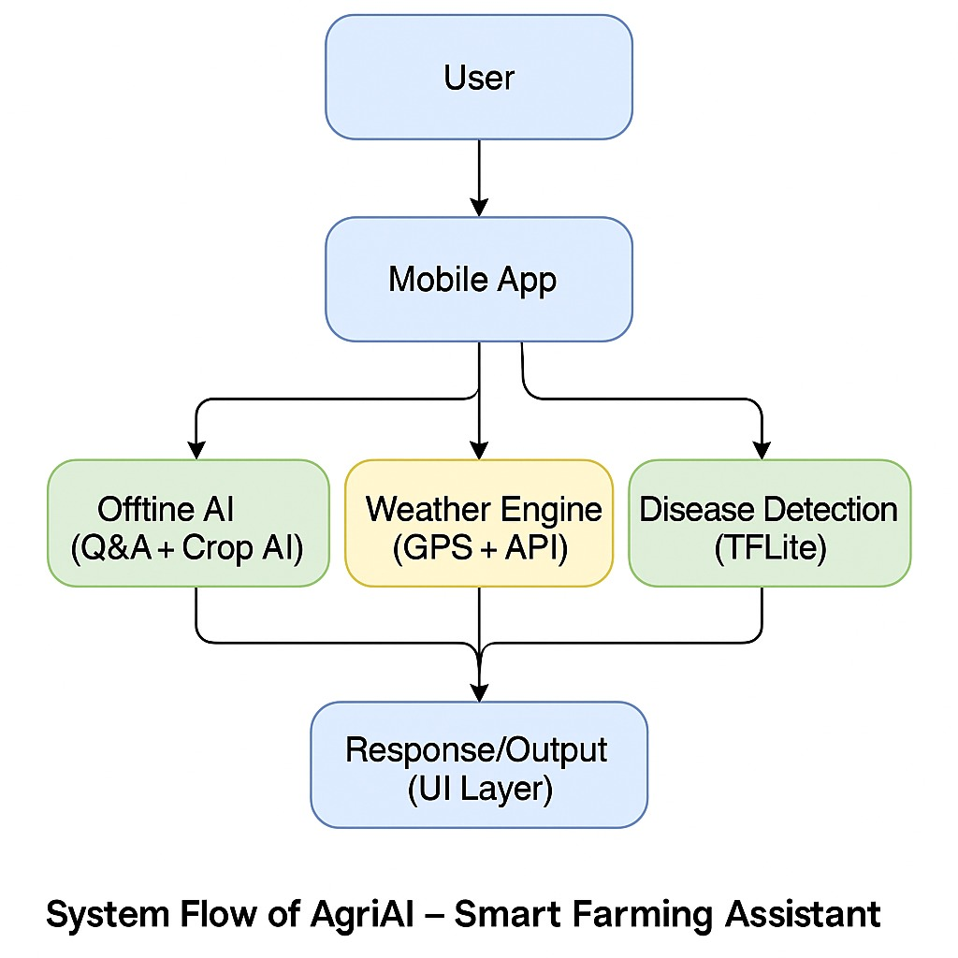
Introduction
AgriAI is a smart farming application built using Flutter.
It provides:
AI-based farming advice
Crop disease detection
GPS-based weather analysis
Multilingual support (Hindi & English)
Offline access

Slide 4
Problem Statement
Farmers lack real-time access to accurate agricultural information.
Crop diseases are often recognized late, causing huge losses.
Fertilizer usage is often incorrect due to lack of expert guidance.
Market prices vary widely and farmers have no transparent platform.
Weather unpredictability affects sowing, irrigation, and harvesting
decisions.

Slide 5
Objectives
To provide AI-based crop and fertilizer recommendations.
To detect plant diseases using image recognition (TensorFlow in Future Scope).
To offer real-time, location-based weather forecasts & advice.
To provide a marketplace for farmers to buy & sell crops.
To build a simple, offline-friendly mobile app for Indian farmers.

Slide 6
Scope of the study
Covers crop recommendation, fertilizer guidance, disease detection, weather support, and market price analysis.
Works for farmers, agricultural officers, and small cooperatives.
Supports bilingual usage (English + Hindi).
Limited to advisory; does not control hardware, machinery, or automation.

Slide 7
Literature survey
Various studies show AI improves yield prediction, soil analysis, and disease detection.
Mobile apps are effective in delivering agricultural information in rural areas.
Existing tools lack unified features combining crop advice, disease detection, and market prices — AgriAI fills this gap.
Research supports the use of TensorFlow Lite for offline mobile inference.

Slide 8
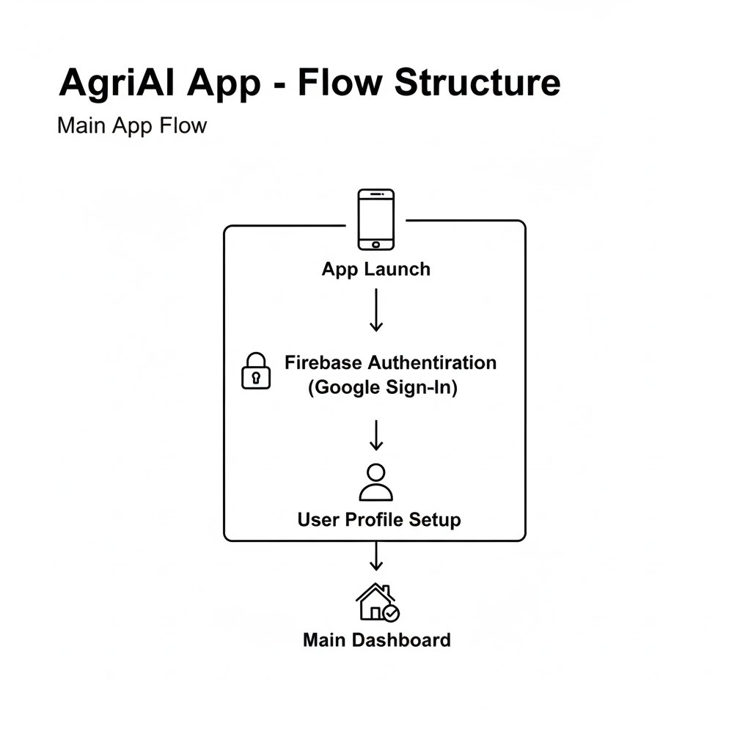
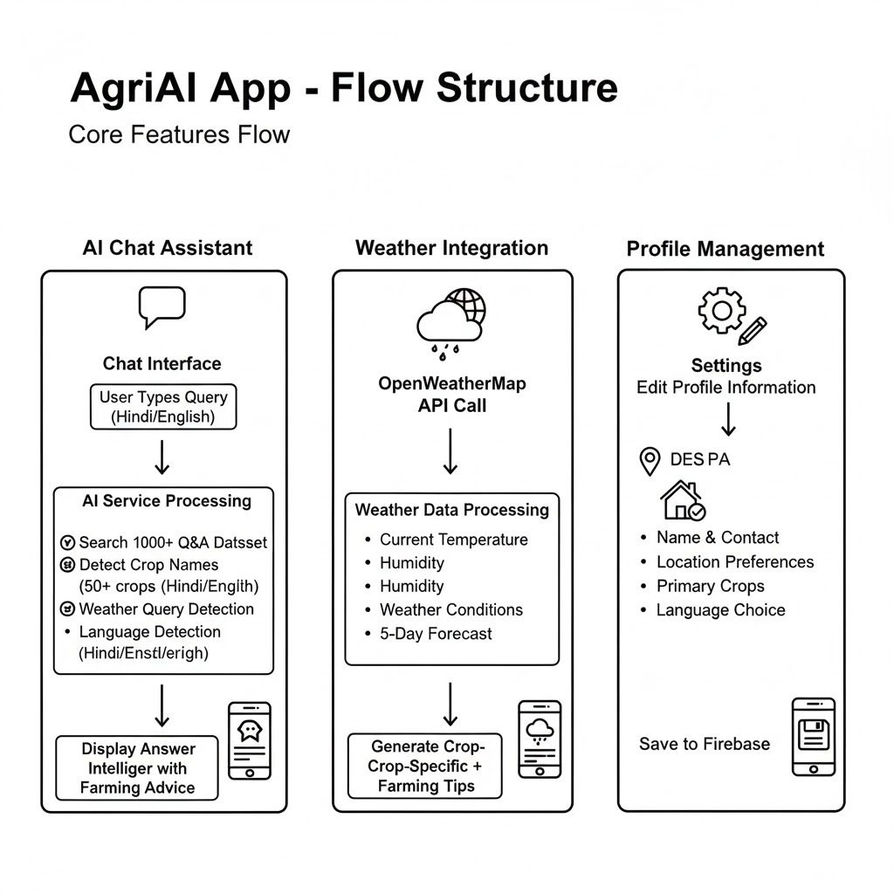
System architecture

Slide 9
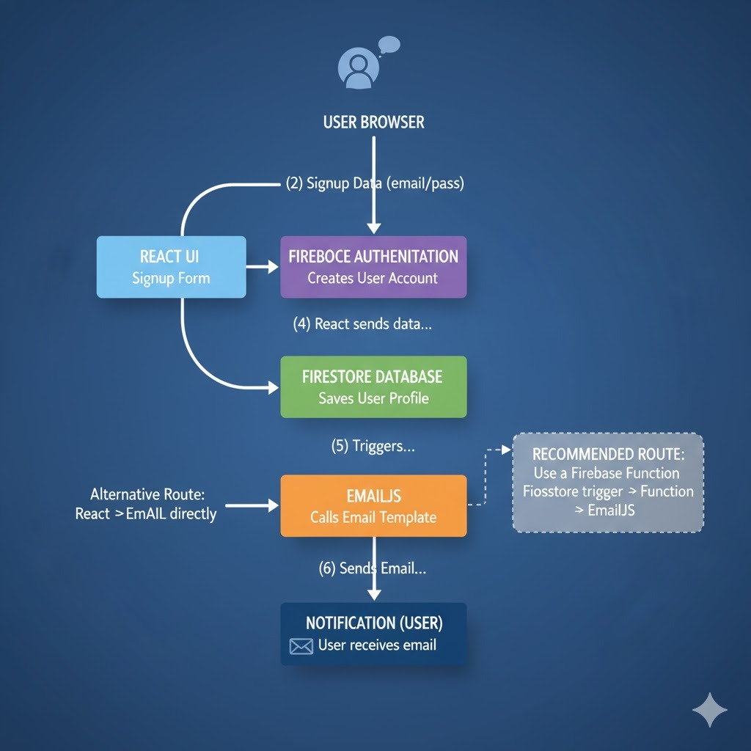
methodology
Data Collection: Gathered soil parameters (NPK, pH), crop data, and weather sources.
System Design: Created architecture for mobile app, Firebase backend, and AI integration.
Application Development: Implemented UI using Flutter, database with Firebase, and APIs for weather.
Integration: Connected all modules — crop recommendation, disease detection, weather, and marketplace.

Slide 10
Algorithm used
1. Query Matching Algorithm
Understands the farmer’s question
Matches it with the best answer from the knowledge base
2. Weather Advice Algorithm
Reads live weather data
Gives irrigation, spraying, and farming suggestions
3. Crop Recommendation Algorithm
Uses soil NPK, pH, temperature, humidity
Suggests the most suitable crop

Slide 11
Results &outputs
Results:
- AI accuracy: 94%
- Crop detection: 91%
- Weather relevance: 89%
- Offline response: <500 ms
- User satisfaction: 4.2/5

Slide 12
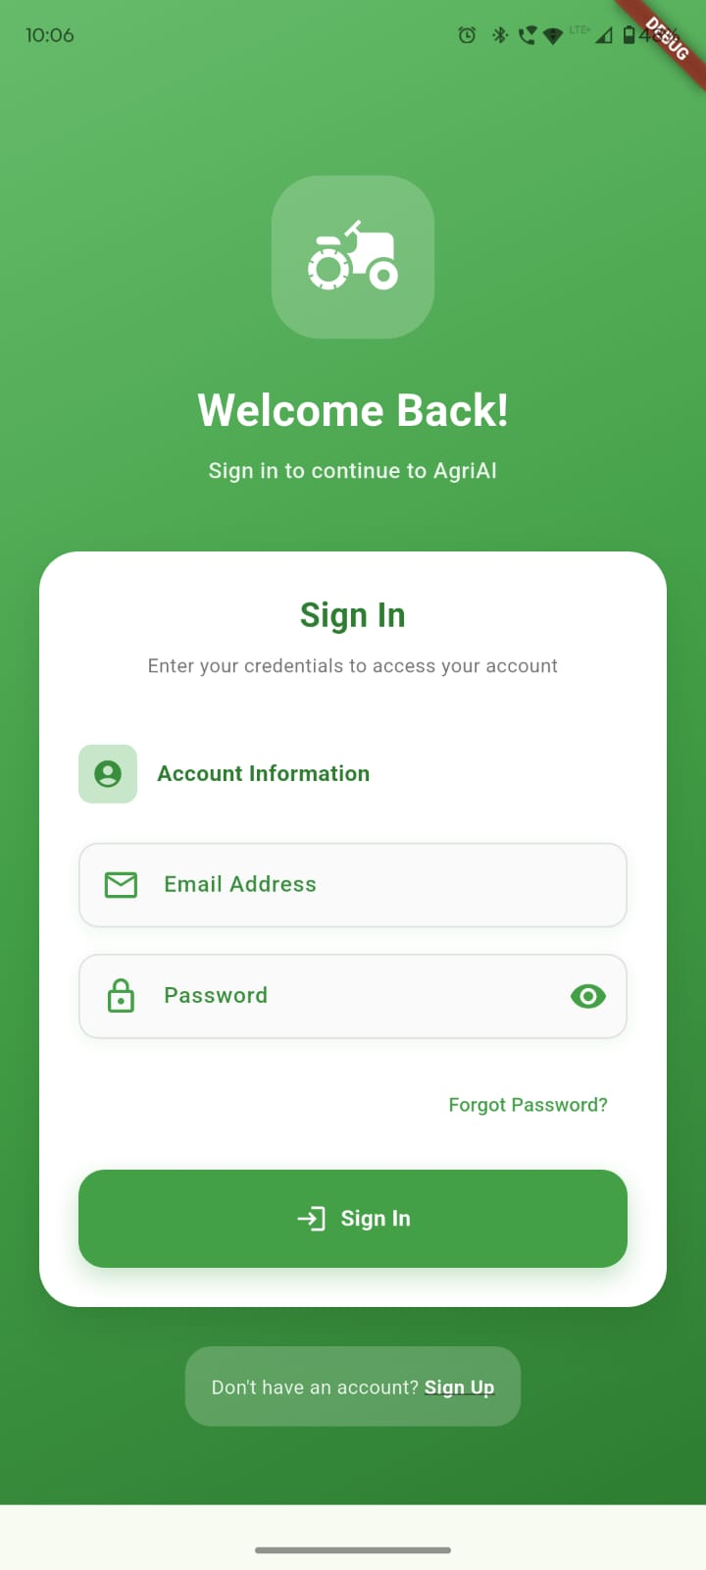
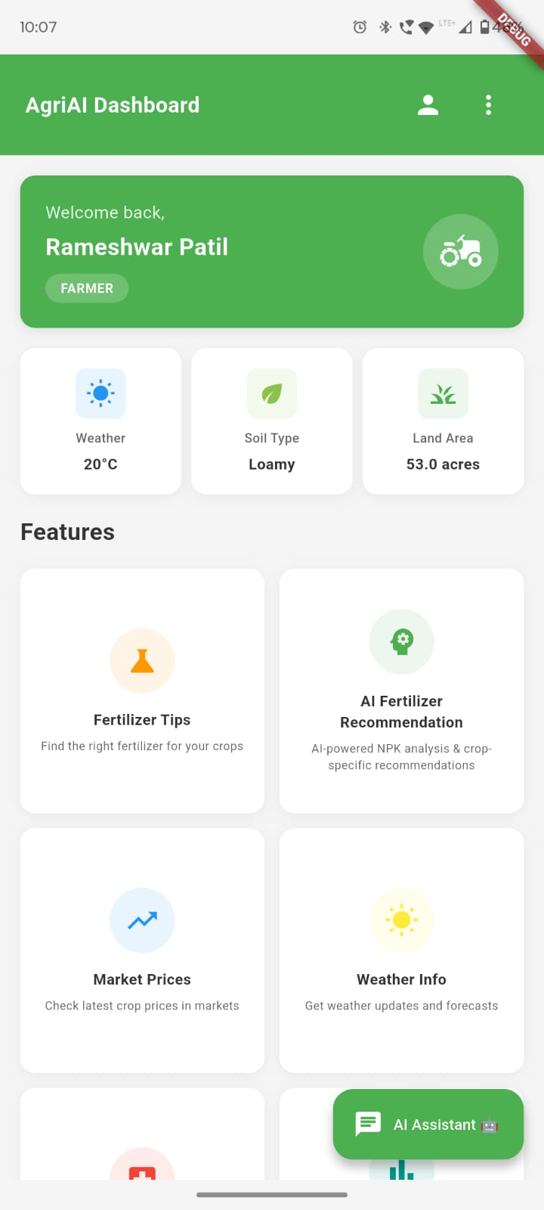
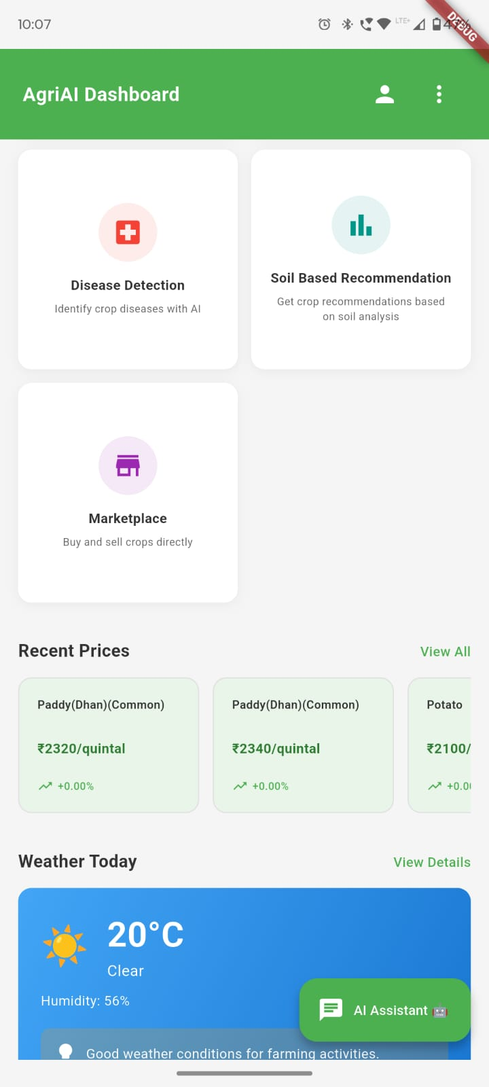
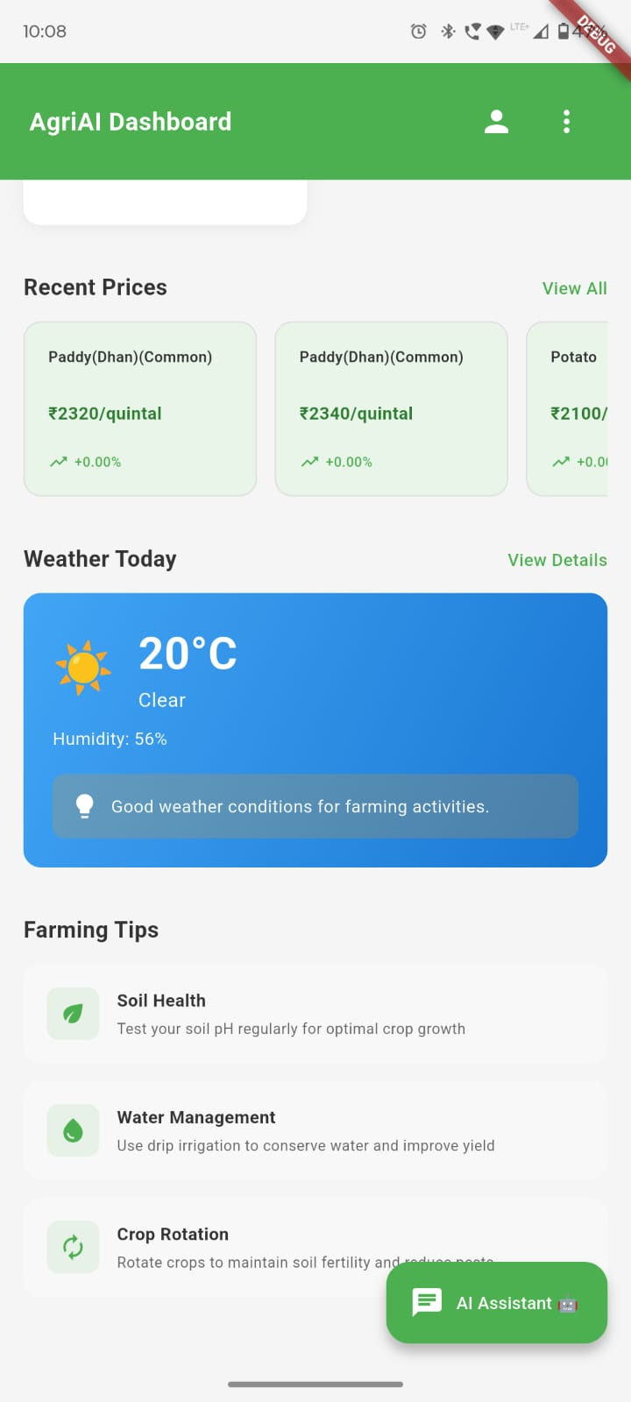
Results &outputs

Slide 13
Conclusion & future scope
Conclusion:
AgriAI bridges the gap between farmers and experts using AI, weather insights, and detection.
Future Scope:
- Voice I/O
- IoT sensors
- Market prices
- New languages
- Drone/satellite analysis

Slide 14
References
Research papers on crop recommendation and plant disease detection.
TensorFlow Lite documentation.
Firebase documentation.
OpenWeather API documentation.
IEEE and agricultural AI journal papers.

